Slide 1

DISCLAIMER
The information in this presentation is provided to you by PT. AXAR Technology Raya, solely for informational purposes and does not constitute an offer to buy, sell or issue, or a solicitation of an offer to sell, buy or acquire any securities of the Company in any jurisdiction or an inducement to enter into investment activity, nor may it or any part of it form the basis of or be relied on in connection with any contract or commitment whatsoever. No representations or warranties, express or implied, are made by the Company, any underwriters, any of their respective affiliates, directors, officers, employees, advisors or representatives with respect to, and no reliance should be placed, on the accuracy, fairness or completeness of the information presented or contained in this presentation. By viewing this presentation, you agree that none of the Company, any underwriters, nor any of their respective affiliates, directors, officers, employees, advisors or representatives accepts any responsibility or liability whatsoever for any loss howsoever arising from any information presented or contained in or derived from or omitted from this presentation. The information presented or contained in this presentation was obtained from various sources, including certain third parties, and has not been independently verified, and its accuracy is not guaranteed.
This presentation does not contain all relevant information relating to the Company or its securities, particularly with respect to the risks and special considerations involved with an investment in the securities of the Company. These materials are not an offer of securities for sale. Any public offering will be made by means of a prospectus that may be obtained from the issuer and that will contain detailed information about the company and management, as well as financial statements. This presentation speaks as of its date and the information presented or contained in this presentation is subject to change without notice or update.
This presentation contains statements that constitute forward-looking statements. These statements include descriptions regarding the intent, belief or current expectations of the Company or its officers about the future. These statements can be recognized by the use of words such as “expects,” “plans,” “will,” “estimates,” “projects,” “intends,” or words of similar meaning. Such forward-looking statements are not guarantees of future performance and involve risks and uncertainties, and actual results may differ from those in the forward-looking statements as a result of various factors and assumptions, many of which are beyond the Company’s control. The Company or any of its affiliates, advisors, representatives or underwriters has no obligation and does not undertake to revise forward-looking statements to reflect future events or circumstances.
THE INFORMATION CONTAINED IN THIS DOCUMENT IS HIGHLY CONFIDENTIAL AND MAY NOT BE FORWARDED, PUBLISHED OR DISTRIBUTED, DIRECTLY OR INDIRECTLY, TO ANY OTHER PERSON (WHETHER WITHIN OR OUTSIDE YOUR ORGANIZATION/FIRM) FOR ANY PURPOSE AND MAY NOT BE REPRODUCED IN ANY MANNER WHATSOEVER. ANY FORWARDING, PUBLICATION, DISTRIBUTION OR REPRODUCTION OF THIS DOCUMENT IN WHOLE OR IN PART IS UNAUTHORIZED.
MOBILE
DEVELOPMENT
DAY 1

Slide 2
OBJECTIVES
SliverAppBar
SliverFillRemaining
SliverList
Notes:
Save Time....:
The Platform will house/aggregate thousands of DIRECT SUPPLIERS. Buyer members are now abled to easily Pick whats best suitable for them.
Discover...:
Suppliers need to be a registered and verified members. There will be features such as ratings and certifications to boost further.
Grow Business:
Members akan di-empowered dengan sebuah tool digital yang yang tadinya menyerang industri, malah justru membuat mereka bisa menjadi lebih kompetitif di era digital.

Slide 3
Sliver
Pada flutter, seluruh elemen UI adalah widget. Namun terdapat sebuah widget khusus yaitu sliver. Sliver memiliki properti tambahan dibandingkan widget umumnya.
Terdapat banyak jenis sliver pada flutter, diantaranya :
SliverAppBar
SliverFillRemaining
SliverList
Notes:
Save Time....:
The Platform will house/aggregate thousands of DIRECT SUPPLIERS. Buyer members are now abled to easily Pick whats best suitable for them.
Discover...:
Suppliers need to be a registered and verified members. There will be features such as ratings and certifications to boost further.
Grow Business:
Members akan di-empowered dengan sebuah tool digital yang yang tadinya menyerang industri, malah justru membuat mereka bisa menjadi lebih kompetitif di era digital.

Slide 4
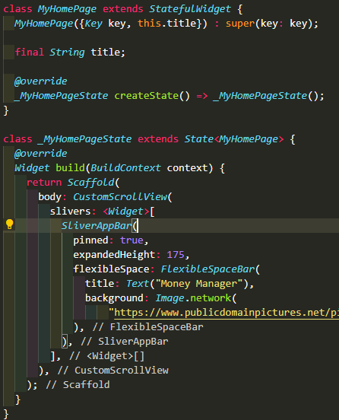
SliverAppBar
SliverAppBar merupakan sebuah appbar yang dapat di minimize dan di extend.
Adapun cara menggunakan sliver appbar adalah sebagai berikut :
Silahkan buat project baru, dan tambahkan kode seperti contoh dibawah ini.
note :
background pada program disamping menggunakan image.network(“link_gambar”).
Notes:
Save Time....:
The Platform will house/aggregate thousands of DIRECT SUPPLIERS. Buyer members are now abled to easily Pick whats best suitable for them.
Discover...:
Suppliers need to be a registered and verified members. There will be features such as ratings and certifications to boost further.
Grow Business:
Members akan di-empowered dengan sebuah tool digital yang yang tadinya menyerang industri, malah justru membuat mereka bisa menjadi lebih kompetitif di era digital.

Slide 5
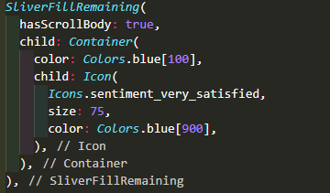
SliverAppBar
Sliver harus dibungkus menggunakan CustomScrollView atau jenis ScrollView lainnya, kemudian menggunakan attribut sliver yang dapat diinputkan list dari widget sliver.
Pada contoh sebelumnya, kita telah menampah sebuah SliverAppBar.
Berikutnya kita akan menambahkan SliverFillRemaining.
Notes:
Save Time....:
The Platform will house/aggregate thousands of DIRECT SUPPLIERS. Buyer members are now abled to easily Pick whats best suitable for them.
Discover...:
Suppliers need to be a registered and verified members. There will be features such as ratings and certifications to boost further.
Grow Business:
Members akan di-empowered dengan sebuah tool digital yang yang tadinya menyerang industri, malah justru membuat mereka bisa menjadi lebih kompetitif di era digital.

Slide 6
SliverFillRemaining
SliverFillRemaining merupakan widget mengukur child-nya untuk mengisi viewport pada crossAxisnya. Luasnya sliver dan ukuran child-nya di sumbu utama dihitung secara bersyarat, yang dijelaskan lebih detail di bawah ini.
Saat SliverFillRemaining memiliki turunan yang dapat digulir
Bendera hasScrollBody menunjukkan apakah turunan sliver memiliki badan yang dapat di-scroll. Nilai ini tidak pernah nol, dan defaultnya adalah true. Contoh umum dari penggunaan ini adalah NestedScrollView. Dalam kasus ini, sliver akan mengukur anaknya untuk memenuhi batas maksimum yang tersedia. SliverFillRemaining tidak akan membatasi area yang dapat di-scroll, karena berpotensi memiliki kedalaman tak terbatas. Ini juga berlaku untuk kasus penggunaan seperti ScrollView saat ScrollView.shrinkWrap benar.
Notes:
Save Time....:
The Platform will house/aggregate thousands of DIRECT SUPPLIERS. Buyer members are now abled to easily Pick whats best suitable for them.
Discover...:
Suppliers need to be a registered and verified members. There will be features such as ratings and certifications to boost further.
Grow Business:
Members akan di-empowered dengan sebuah tool digital yang yang tadinya menyerang industri, malah justru membuat mereka bisa menjadi lebih kompetitif di era digital.

Slide 7
SliverFillRemaining
Jika SliverFillRemaining tidak memiliki turunan yang dapat digulir
Ketika hasScrollBody disetel ke false, ukuran anak diperhitungkan saat mempertimbangkan sejauh mana ia harus mengisi ruang. Sejauh mana sliver sebelumnya telah di-scroll juga dipertimbangkan dalam memutuskan cara menata sliver ini.
SliverFillRemaining akan mengukur turunannya untuk mengisi area pandang di sumbu utama jika ruang tersebut lebih besar dari jangkauan anak, dan jumlah ruang yang telah digulir sebelumnya tidak melebihi luas area pandang sumbu utama.
Notes:
Save Time....:
The Platform will house/aggregate thousands of DIRECT SUPPLIERS. Buyer members are now abled to easily Pick whats best suitable for them.
Discover...:
Suppliers need to be a registered and verified members. There will be features such as ratings and certifications to boost further.
Grow Business:
Members akan di-empowered dengan sebuah tool digital yang yang tadinya menyerang industri, malah justru membuat mereka bisa menjadi lebih kompetitif di era digital.

Slide 8
SliverList
Sliver yang menempatkan children-nya dalam larik linier di sepanjang main-axis.
Setiap turunan dipaksa untuk memiliki SliverConstraints.crossAxisExtent di sumbu silang tetapi menentukan luas main axis-nya sendiri.
SliverList menentukan offset scrollnya dengan "dead reckoning" karena turunan di luar bagian yang terlihat dari sliver tidak terwujud, yang berarti SliverList tidak dapat mempelajari jangkauan sumbu utamanya. Sebaliknya, anak-anak yang baru terwujud ditempatkan berdekatan dengan anak-anak yang sudah ada.
Notes:
Save Time....:
The Platform will house/aggregate thousands of DIRECT SUPPLIERS. Buyer members are now abled to easily Pick whats best suitable for them.
Discover...:
Suppliers need to be a registered and verified members. There will be features such as ratings and certifications to boost further.
Grow Business:
Members akan di-empowered dengan sebuah tool digital yang yang tadinya menyerang industri, malah justru membuat mereka bisa menjadi lebih kompetitif di era digital.

Slide 9
SliverList
Child elements' lifecycle
Creation
Saat menyusun daftar, elemen children yang terlihat, status, dan objek render akan dibuat secara lazied berdasarkan widget yang ada (seperti dalam kasus SliverChildListDelegate) atau yang disediakan secara lazied (seperti dalam kasus SliverChildBuilderDelegate).
Destruction
Ketika seorang anak di-scroll keluar dari tampilan, subpohon elemen terkait, status, dan objek render dimusnahkan. Anak baru pada posisi yang sama di sliver akan dibuat ulang secara lazied bersama dengan elemen baru, status, dan objek render saat di-scroll kembali.
Notes:
Save Time....:
The Platform will house/aggregate thousands of DIRECT SUPPLIERS. Buyer members are now abled to easily Pick whats best suitable for them.
Discover...:
Suppliers need to be a registered and verified members. There will be features such as ratings and certifications to boost further.
Grow Business:
Members akan di-empowered dengan sebuah tool digital yang yang tadinya menyerang industri, malah justru membuat mereka bisa menjadi lebih kompetitif di era digital.

Slide 10
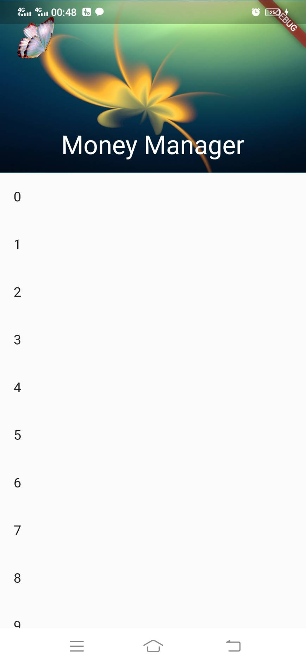
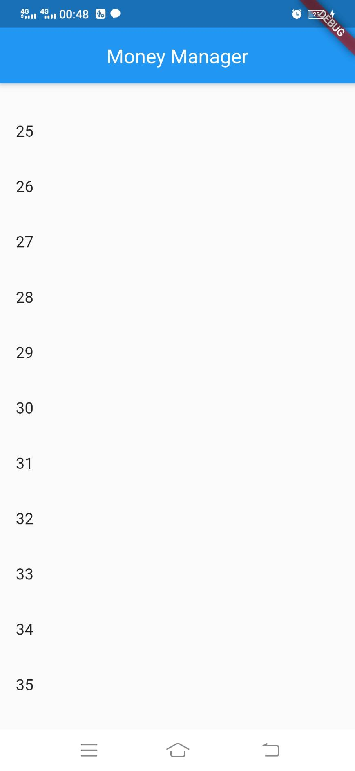
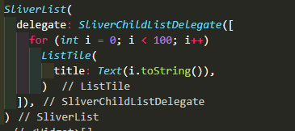
SliverAppBar
Berikut ini adalah contoh pengguna SliverList.
Pada potongan program disamping dapat dilihat bahwa kita men-generate sebuah list berupa text sebanyak 100 buah ListTile.
Notes:
Save Time....:
The Platform will house/aggregate thousands of DIRECT SUPPLIERS. Buyer members are now abled to easily Pick whats best suitable for them.
Discover...:
Suppliers need to be a registered and verified members. There will be features such as ratings and certifications to boost further.
Grow Business:
Members akan di-empowered dengan sebuah tool digital yang yang tadinya menyerang industri, malah justru membuat mereka bisa menjadi lebih kompetitif di era digital.

Slide 11
DISCLAIMER
The information in this presentation is provided to you by PT. AXAR Technology Raya, solely for informational purposes and does not constitute an offer to buy, sell or issue, or a solicitation of an offer to sell, buy or acquire any securities of the Company in any jurisdiction or an inducement to enter into investment activity, nor may it or any part of it form the basis of or be relied on in connection with any contract or commitment whatsoever. No representations or warranties, express or implied, are made by the Company, any underwriters, any of their respective affiliates, directors, officers, employees, advisors or representatives with respect to, and no reliance should be placed, on the accuracy, fairness or completeness of the information presented or contained in this presentation. By viewing this presentation, you agree that none of the Company, any underwriters, nor any of their respective affiliates, directors, officers, employees, advisors or representatives accepts any responsibility or liability whatsoever for any loss howsoever arising from any information presented or contained in or derived from or omitted from this presentation. The information presented or contained in this presentation was obtained from various sources, including certain third parties, and has not been independently verified, and its accuracy is not guaranteed.
This presentation does not contain all relevant information relating to the Company or its securities, particularly with respect to the risks and special considerations involved with an investment in the securities of the Company. These materials are not an offer of securities for sale. Any public offering will be made by means of a prospectus that may be obtained from the issuer and that will contain detailed information about the company and management, as well as financial statements. This presentation speaks as of its date and the information presented or contained in this presentation is subject to change without notice or update.
This presentation contains statements that constitute forward-looking statements. These statements include descriptions regarding the intent, belief or current expectations of the Company or its officers about the future. These statements can be recognized by the use of words such as “expects,” “plans,” “will,” “estimates,” “projects,” “intends,” or words of similar meaning. Such forward-looking statements are not guarantees of future performance and involve risks and uncertainties, and actual results may differ from those in the forward-looking statements as a result of various factors and assumptions, many of which are beyond the Company’s control. The Company or any of its affiliates, advisors, representatives or underwriters has no obligation and does not undertake to revise forward-looking statements to reflect future events or circumstances.
THE INFORMATION CONTAINED IN THIS DOCUMENT IS HIGHLY CONFIDENTIAL AND MAY NOT BE FORWARDED, PUBLISHED OR DISTRIBUTED, DIRECTLY OR INDIRECTLY, TO ANY OTHER PERSON (WHETHER WITHIN OR OUTSIDE YOUR ORGANIZATION/FIRM) FOR ANY PURPOSE AND MAY NOT BE REPRODUCED IN ANY MANNER WHATSOEVER. ANY FORWARDING, PUBLICATION, DISTRIBUTION OR REPRODUCTION OF THIS DOCUMENT IN WHOLE OR IN PART IS UNAUTHORIZED.
THANK YOU

